Slide 1


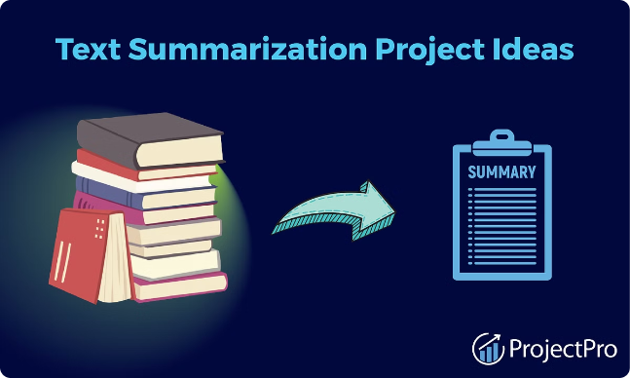
Project Title:
Text summarization using
text to text transfer transformer
Team-Abhinav Khatiyan
Aman Sharma
Mohd Shariq
Mehtab Shaikh
Guided By:
Assistant Prof. Abhishek Kumar

Slide 2

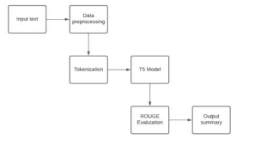
Problem Statement:
In today's information-rich world, the abundance of textual data makes it increasingly challenging for individuals to consume and extract meaningful insights efficiently.

Slide 3

Introduction to Text Summarization
Definition
Purpose
Text summarization is the process of condensing a lengthy document or article into a concise and informative summary, capturing the key points and essential information.
Summarization helps readers quickly grasp the main ideas and salient points of a text, saving time and effort compared to reading the full document.
Applications
Summarization has diverse applications, from news article summaries to academic paper abstracts, making large volumes of text more accessible and digestible.

Slide 4

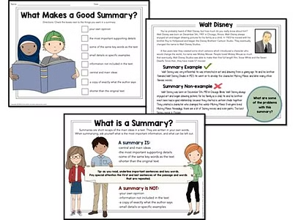
Challenges in Text Summarization
Capturing the essential meaning and key information from long, complex documents while preserving coherence and context.
Handling ambiguity and linguistic nuance to accurately summarize the intended message of the source text.
Developing abstractive summarization models that can generate novel, human-like sentences rather than just extracting sentences from the original text.

Slide 5

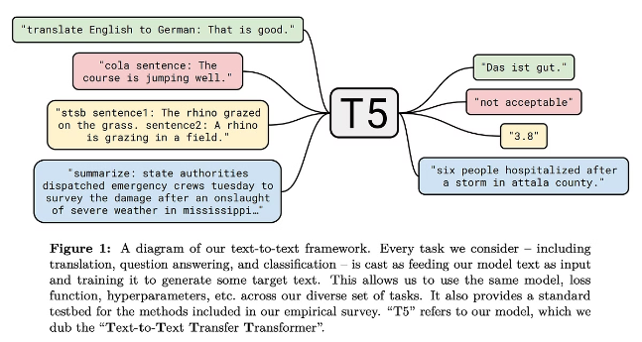
Overview of Text-to-Text Transfer Transformer (T5)
The Text-to-Text Transfer Transformer (T5) is a powerful deep learning model developed by researchers at Google AI. It is a generative language model that can be fine-tuned for a wide range of text-to-text tasks, including summarization, translation, and question answering.
T5 is based on the Transformer architecture and is pre-trained on a massive corpus of web data, allowing it to capture rich linguistic knowledge. This pre-training enables T5 to effectively transfer its learned capabilities to downstream tasks with relatively little fine-tuning.

Slide 6
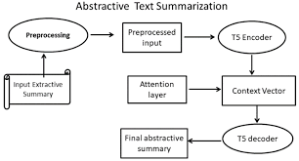
T5 Architecture and Model Components
The Text-to-Text Transfer Transformer (T5) is a multi-task neural network model designed for a wide range of natural language processing tasks. The core architecture is based on the popular Transformer model, with encoder and decoder components.
T5 utilizes a prefix-based approach, where the input and output are both text sequences. This allows the model to be fine-tuned on diverse tasks by simply rephrasing the input and output as text.

Slide 7


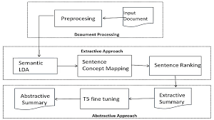
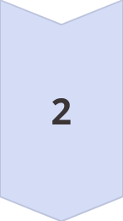

T5 Pre-training and Fine-tuning
Pre-training Stage
T5 is pre-trained on a massive corpus of text data, allowing the model to learn general language understanding and generation capabilities.
Unsupervised Pre-training
The pre-training process is unsupervised, using self-supervised objectives like masked language modeling to learn contextual representations.
Fine-tuning for Summarization
Once pre-trained, T5 is fine-tuned on specific summarization datasets, allowing it to adapt and specialize for the task at hand.

Slide 8
Evaluation Metrics for Text Summarization
1
ROUGE
2
BLEU
The ROUGE metric evaluates summary quality by comparing it to reference summaries, measuring overlapping n-grams.
BLEU assesses the similarity between the generated summary and high-quality human-written references.
3
Coherence and Fluency
4
Informativeness
These metrics evaluate the logical flow and readability of the summary, ensuring it is well-structured.
This measure judges how well the summary captures the key information and topics of the source text.

Slide 9
Comparison of T5 with other Summarization Models
Strengths of T5
Flexibility of T5
Scalability of T5
Limitations of T5
T5 outperforms other models in abstractive summarization, generating more concise and coherent summaries. Its pre-training on a large text corpus allows it to better understand language and context.
T5 can be fine-tuned for various text-to-text generation tasks, from translation to question answering, making it a more versatile model compared to task-specific summarizers.
T5's modular architecture and ability to leverage vast amounts of pre-training data allows it to be scaled to larger model sizes, boosting its performance on challenging summarization datasets.
While powerful, T5 can still struggle with maintaining factual accuracy and coherence in longer summaries. It may also require more fine-tuning data compared to extractive summarization models.

Slide 10
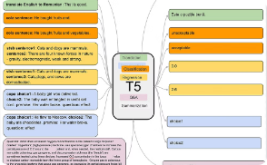
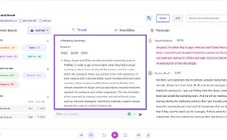
Applications of T5 in Text Summarization
Summarizing News Articles
Summarizing Academic Papers
Summarizing Customer Reviews
Summarizing Meeting Transcripts
T5 has shown impressive performance in summarizing long-form news articles, capturing the key points and insights while reducing the text to a concise, readable summary.
The versatility of T5 allows it to effectively summarize complex academic papers, extracting the core ideas, findings, and conclusions to aid researchers and students.
T5 can quickly digest lengthy customer reviews and produce high-quality summaries, helping businesses better understand customer sentiment and feedback.
T5 can assist in summarizing meeting transcripts, distilling key action items, decisions, and insights to improve productivity and information retention.

Slide 11
Limitations and Future Directions
Despite the impressive performance of T5 in text summarization, there are still limitations and opportunities for future development.
The model's reliance on large pre-training datasets can be a challenge for low-resource languages or domains.
Additionally, further research is needed to improve the factual accuracy and coherence of generated summaries.
Looking ahead, integrating T5 with other advanced techniques, such as reinforcement learning or generative adversarial networks, could lead to even more powerful and versatile summarization models.
Exploring multimodal summarization, which combines text and visual information, is another promising area for future exploration.

Slide 12
Thank You!

